Slide 1
Offerings Gallery Prepared For:
Enter name or
insert logo
Date

Slide 2
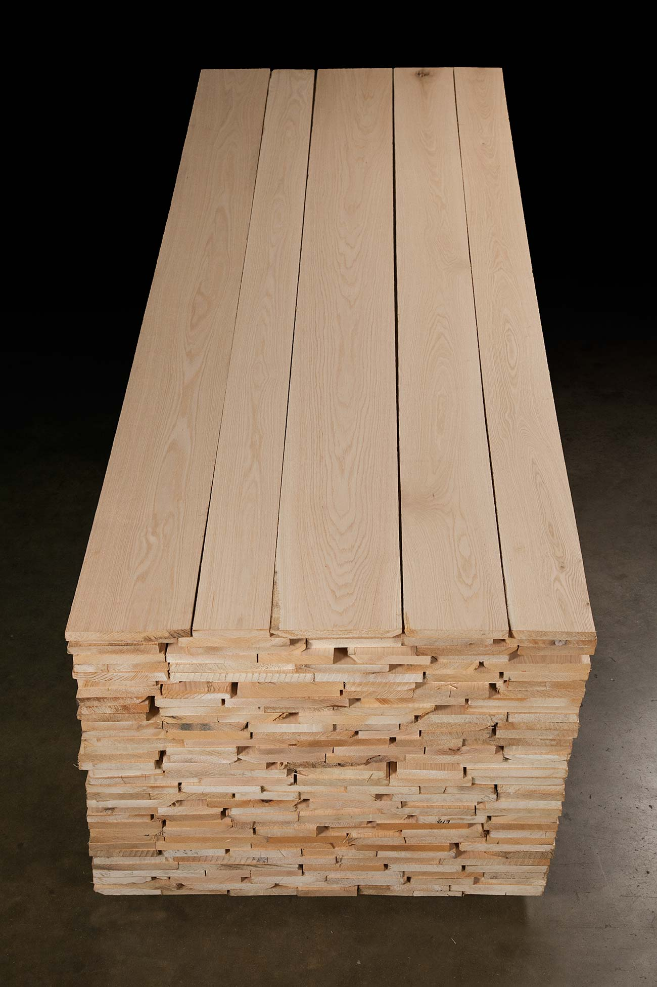
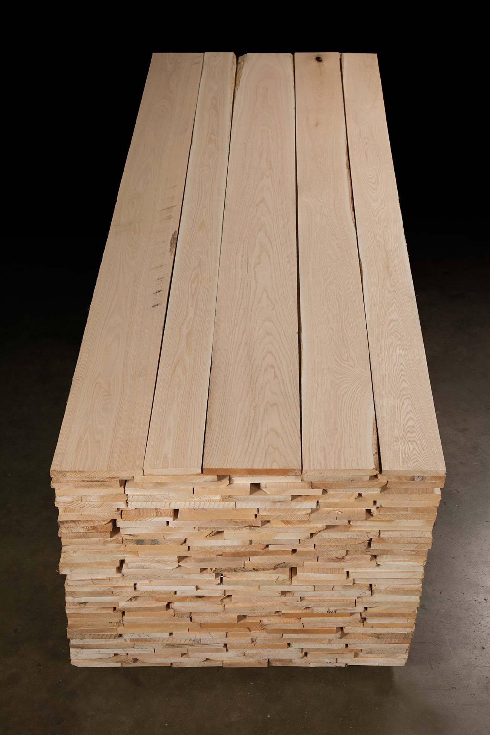
<Wood Type and Specifications Go Here>
Why it is special
Additional info goes here
Additional info goes here
Additional info goes here
Additional info goes here

Slide 3
Section Title

Slide 4
Welcome to Banks Hardwoods – White Pigeon, MI
White Pigeon, MI Facility
This tour will give you an brief overview of our main production facility
Our largest of 3 facilities, this location has the most diverse production and breadth of product offerings
Also where our main offices are located

